Slide 1


Social Interaction Assistant An Assistive and Rehabilitative Technology to Enrich the Social Interactions for Individuals who are Blind and Visually Impaired
CUbiC
CENTER FOR COGNITIVE UBIQUITOUS COMPUTING
Sreekar Krishna
Committee:
Dr. Sethuraman (Panch) Panchanathan, Chair
Dr. Baoxin Li Dr. Michelle (Lani) Shiota
Dr. Gang Qian Dr. John Black
ARIZONA STATE UNIVERSITY

Slide 2
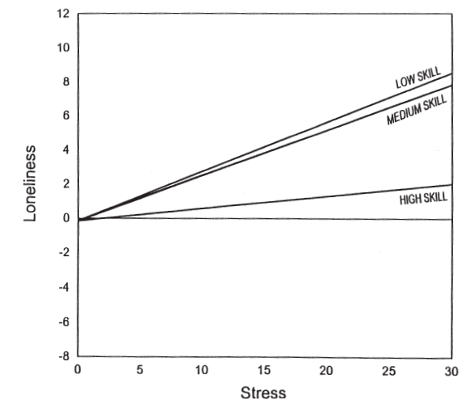
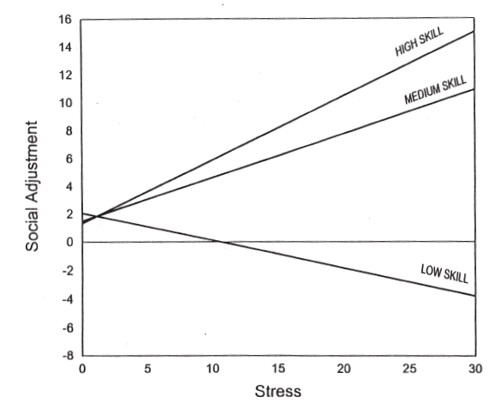
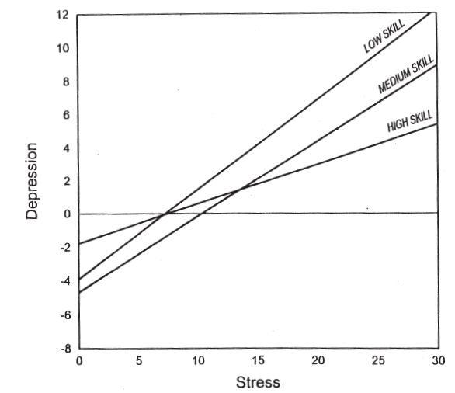
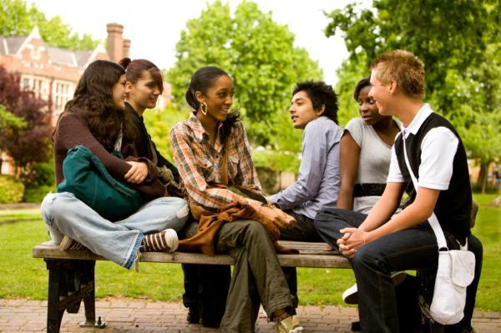

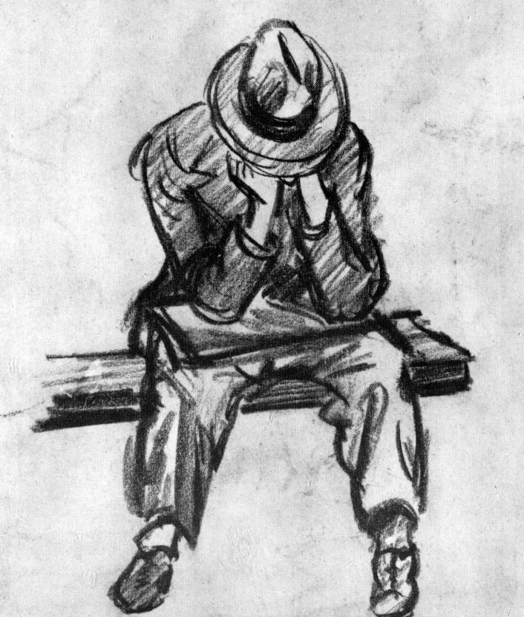

Importance of Social Skills
Loneliness
Social Adjustment
Depression
Social Skills
Verbal
Nonverbal
Skill in
Verbal expression
Verbal fluency
Initiating conversation
Skill in communicating
Affect
Attitude
Status
Emotion
The Work and Social Adjustment Scale
UCLA Loneliness Scale
Beck Depression Inventory
CENTER FOR COGNITIVE UBIQUITOUS COMPUTING

Slide 3
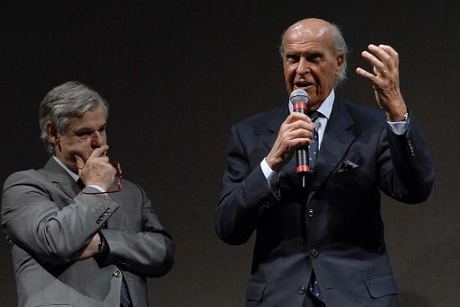
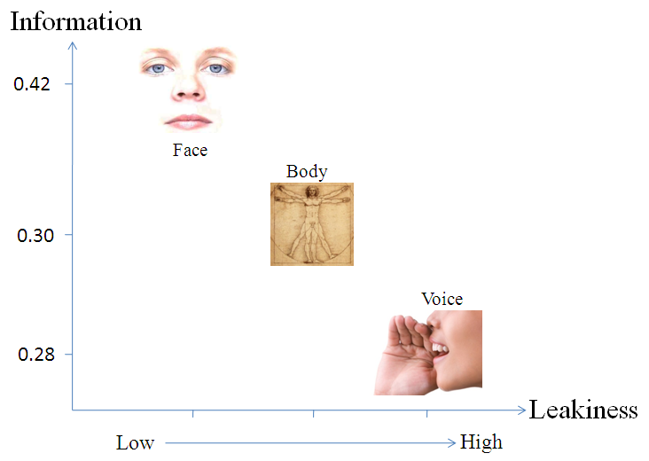
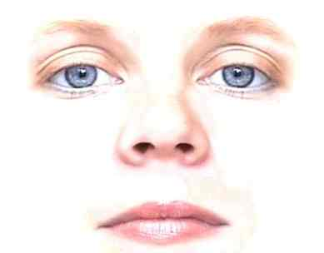
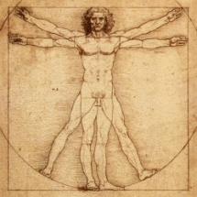
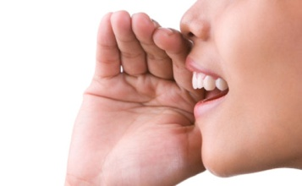
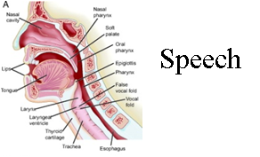
Non Verbal Cues
Enactor - Encoding
Recipient - Decoding
Face
Non Verbal
Verbal
Visual (46%)
Non-verbal (65%)
Body
Voice
Audio (54 %)
Verbal
65%
Verbal (35%)
Face and Body
Nonverbal
Prosody
Speech
CENTER FOR COGNITIVE UBIQUITOUS COMPUTING

Slide 4
Visual Non-Verbal Cues in Communication
Sensory Deficit
Visual Impairment
Blindness
Low Vision
Communication Environment
Physical Attributes of the Partner
Behavior of the partner
Familiarity of the environment
Colors in the environment
Other people in the environment
Architectural Designs
Objects in the environment
Sounds
Lighting
Temperature
The human facial attractiveness
body shape
height of a person
self image
body color
body smell
body hair
clothing
personality
body decoration or artifacts
Body
Posture
Face
Expressions
Gesture
Gestures
Eyes

Slide 5
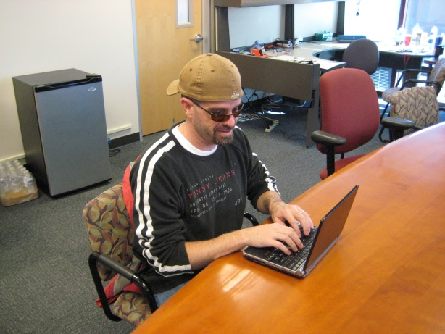
Visual Non-Verbal Cues in Communication
Sensory Deficit
Visual Impairment
Blindness
Low Vision
Focus Group on 8 Social needs
27 participants - 16 blind, 9 low vision and 2 sighted specialists.
Need | Mean Score
Feedback on personal mannerism | 4.5
Understand Facial expression of others | 4.4
Identify people | 4.3
Understand Body gestures | 4.2
Find out number of people in a group | 4.1
Understand other’s attention | 4.0
Other’s physical appearance change from before | 3.5
Other’s physical appearance | 3.4

Slide 6
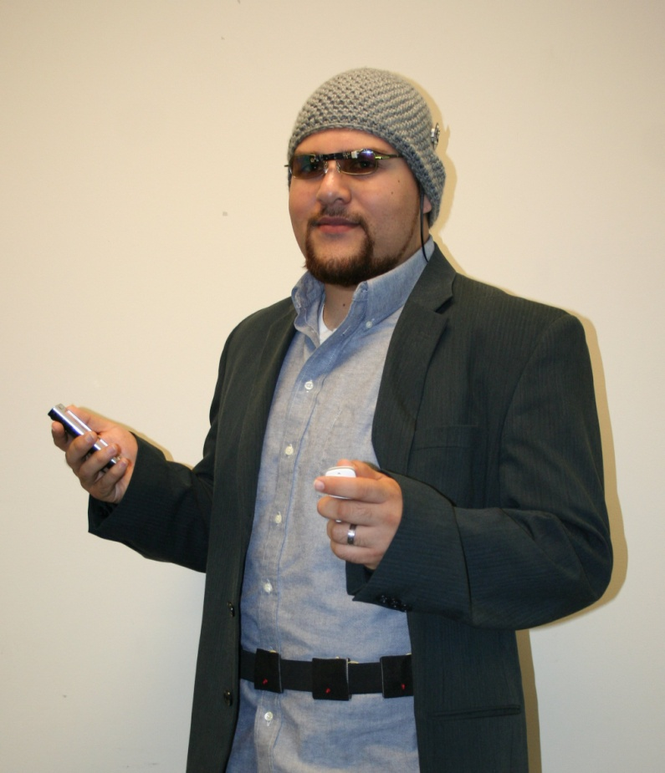
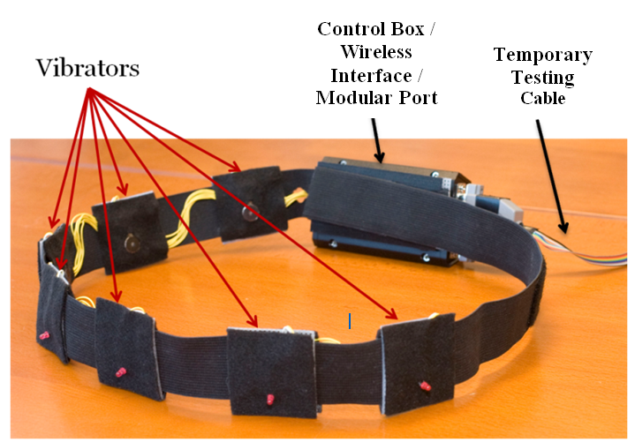
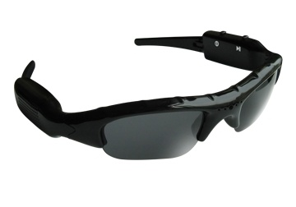
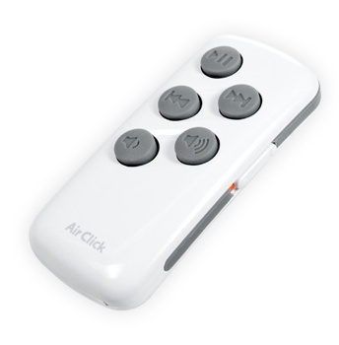
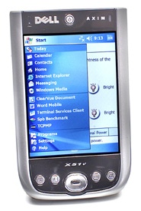
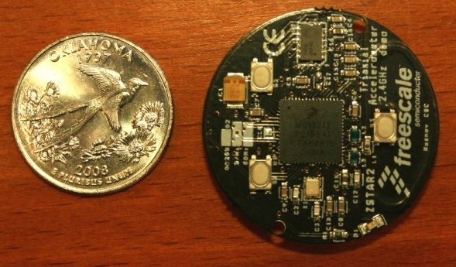
Social Interaction Assistant
Miniature Motion Sensors
Wearable Camera
User Interface
PDA
Haptic Belt

Slide 7
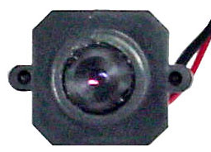
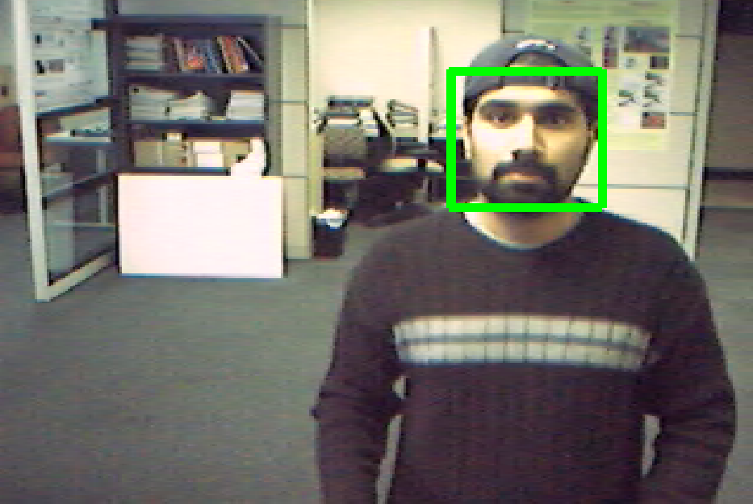
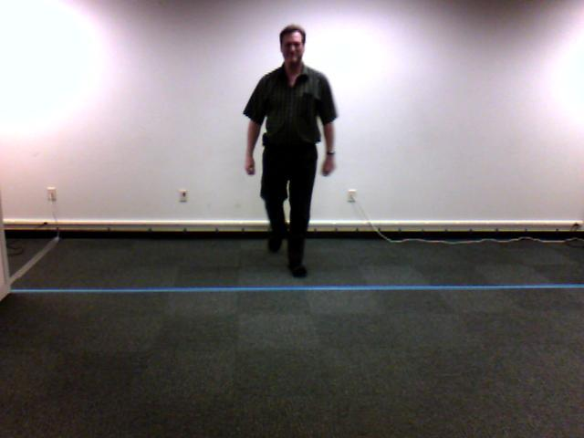
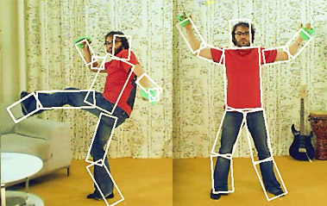
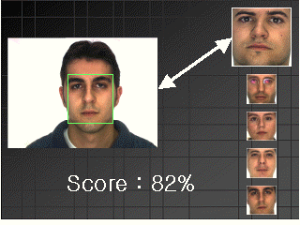
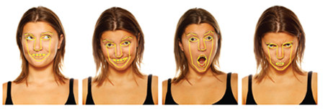
Sensing Technologies
Suite of Algorithms
Person Detection
Person Recognition
Facial Expression
Body Mannerisms
Face Detection
Camera

Slide 8
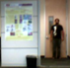
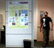
Algorithmic Details 1: Tracking people using Structured Mode Searching Particle Fileter (SMSPF)
Step 1
Step 2
Motivation: Weak Temporal Redundancy
Motivation:ComplexObject Structure & Abrupt Motion
Approach: Deterministic Search over a small probable search space (Histogram of Gradients with Chamfer Match)
Approach: Stochastic Search over
a large search space (Color Histogram Comparison)
Result: Approximate Estimate
Initial Estimate
Corrected Estimate
Example Search Windows
Result: Accurate Estimate

Slide 9
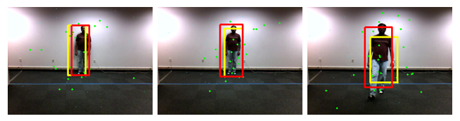
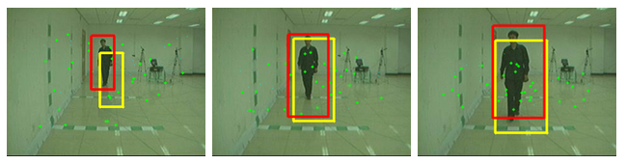
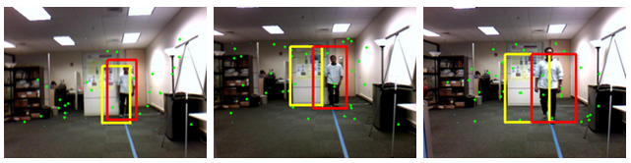
Results – Datasets and Evaluation Metrics
Area Overlap (AO):
Distance b.w Centroids (DC):
Tracking Evaluation Measure (Harmonic Mean of AO & DC )
Evaluation Metrics
DataSet 1 (Collected at CUbiC) : Plain Background; Static Camera; 320x240 resolution
DataSet 2 (CASIA Gait Dataset B with subject approaching the camera) : Slightly cluttered Background; Static Camera; 320x240 resolution
DataSet 3 (Collected at CUbiC) : Cluttered Background; Mobile Camera; 320x240 resolution

Slide 10
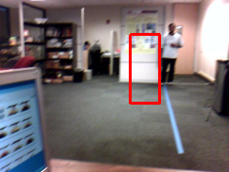
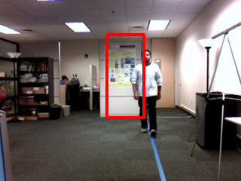
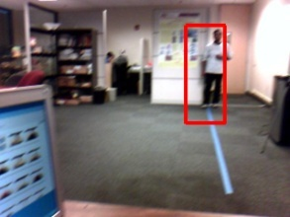
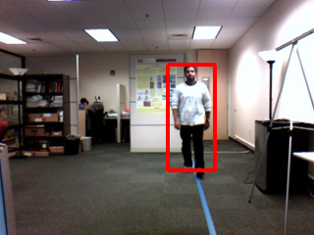
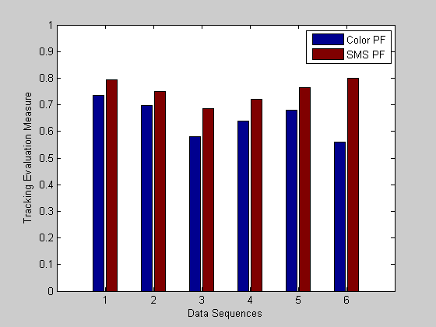
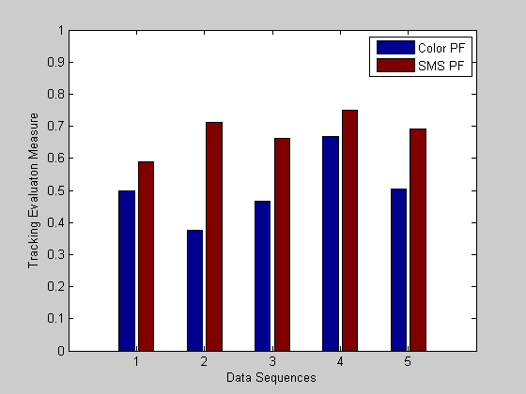
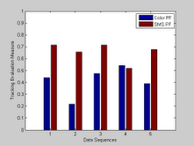
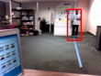
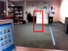
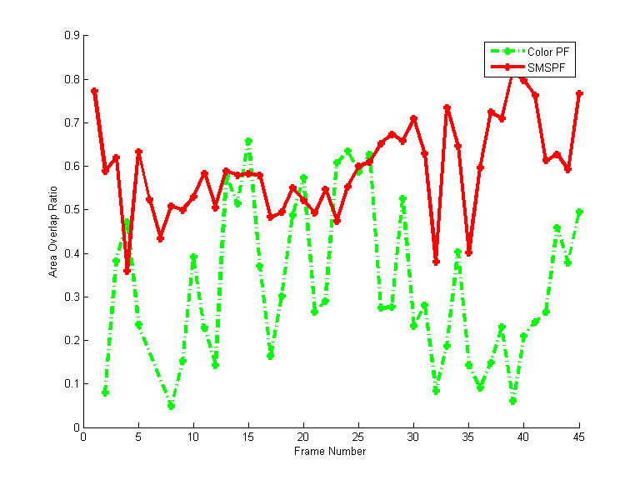
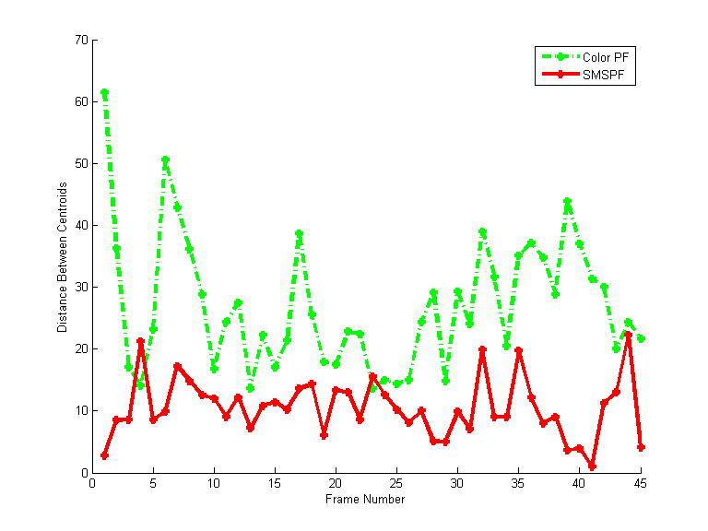
Results – Example Dataset
Results – TEM on the 3 Datasets
#2
#40
#2
#40
Color PF
SMSPF
Clear improvement in tracking results when compared with Numiaro’s Color based particle filtering
Area Overlap Ratio
Distance between Centroids

